Slide 1
Data Structure and Algorithm (PMSCS 623P)
Lecture 16
Graph-Based Algorithms
(MST)

Slide 2
connected
0
0
1
2
1
2
3
3
4
5
6
G1
G2
tree (acyclic graph)

Slide 3
Which graphs are trees?
a
b
a
b
a
b
a
b
d
c
c
d
c
c
d
d
e
f
e
f
e
f
e
f
YES YES NO NO

Slide 4
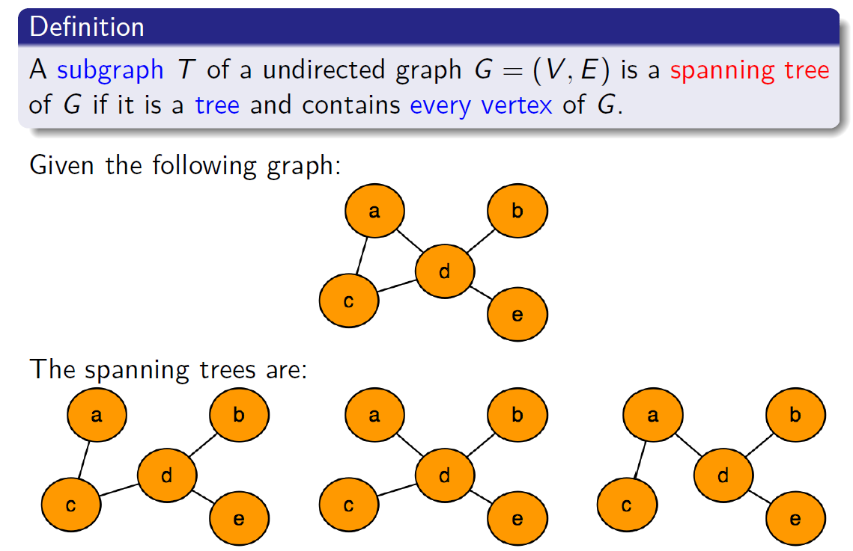
Spanning trees

Slide 5
Spanning trees

Slide 6
Spanning trees

Slide 7
Spanning trees

Slide 8
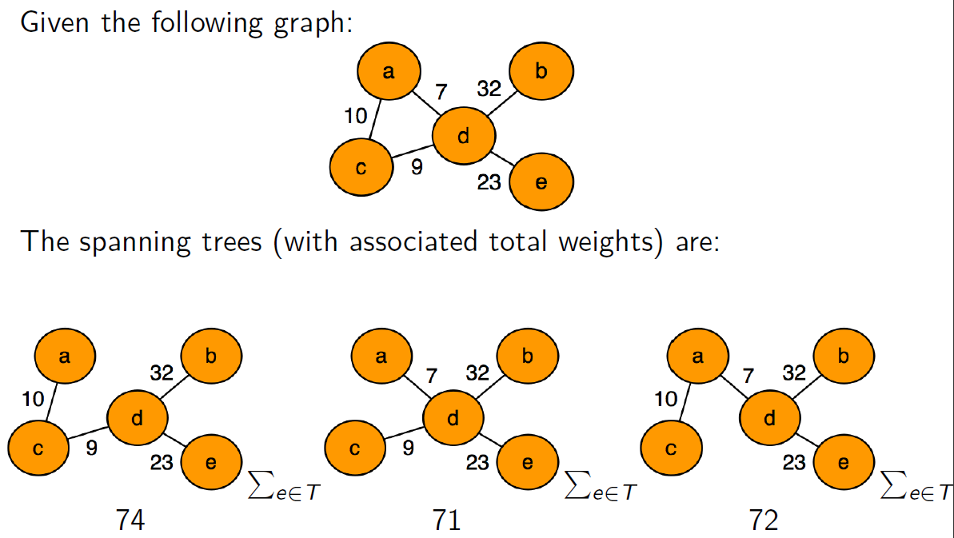
Spanning trees of weighted graphs

Slide 9
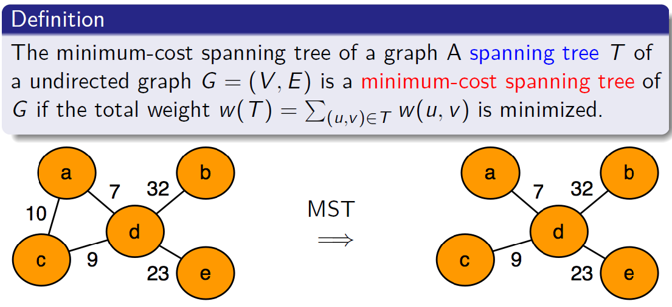
Minimum-cost Spanning Tree (MST)

Slide 10
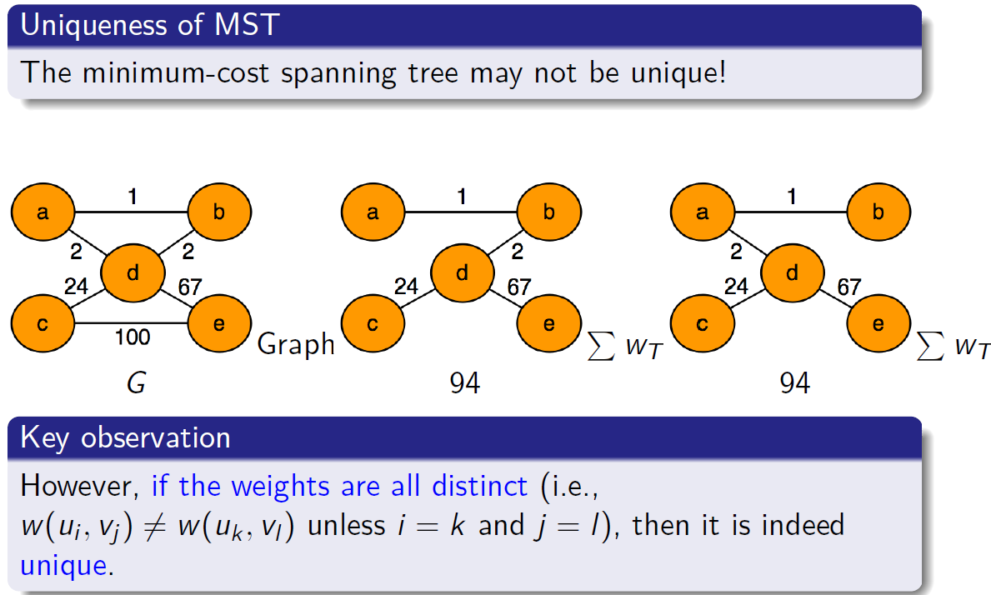

Slide 11
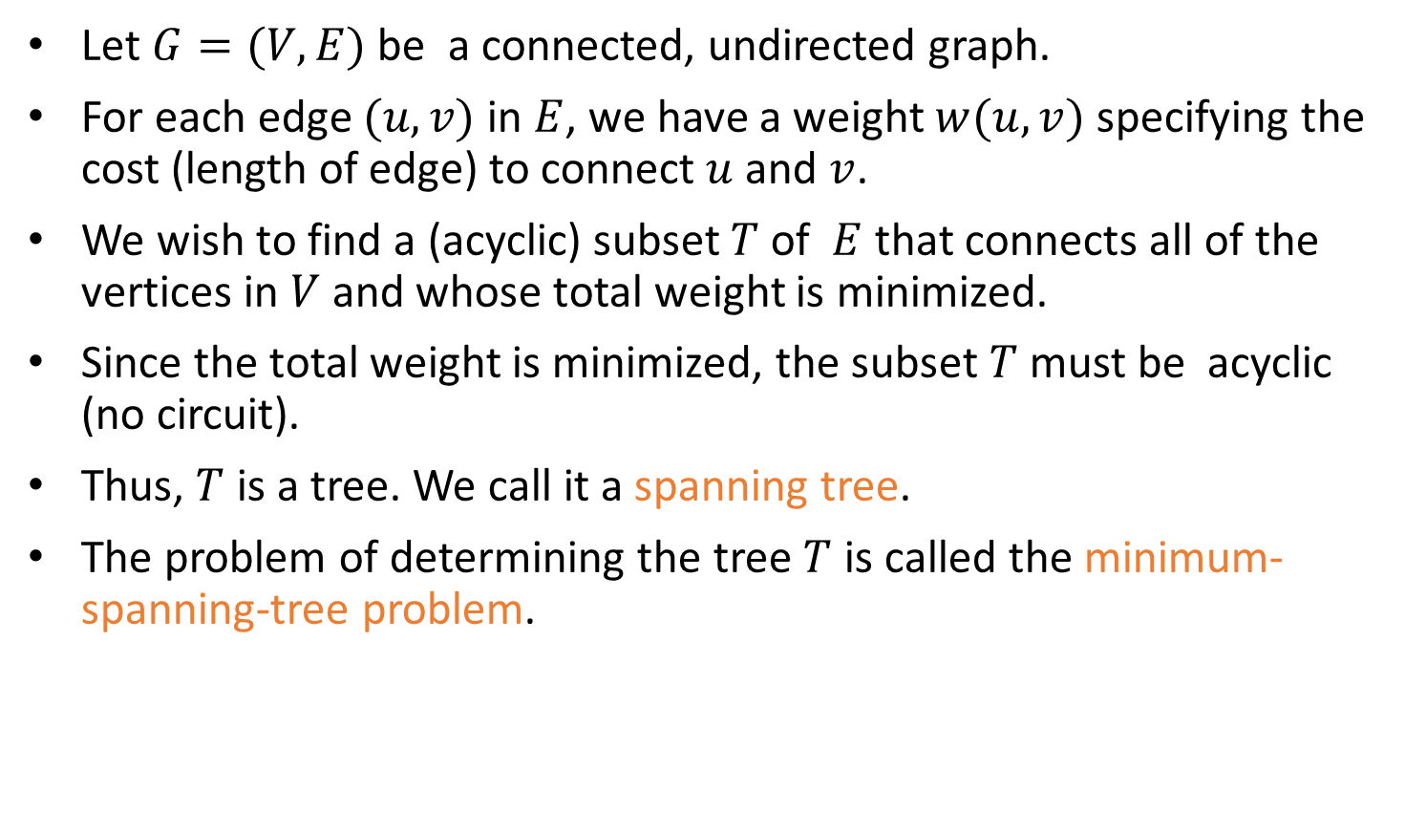
Definition of MST
Let $G=(V,E)$ be a connected, undirected graph.
For each edge $(u,v)$ in $E$, we have a weight $w(u,v)$ specifying the cost (length of edge) to connect $u$ and $v$.
We wish to find a (acyclic) subset $T$ of $E$ that connects all of the vertices in $V$ and whose total weight is minimized.
Since the total weight is minimized, the subset $T$ must be acyclic (no circuit).
Thus, $T$ is a tree. We call it a spanning tree.
The problem of determining the tree $T$ is called the minimum-spanning-tree problem.

Slide 12

Application of MST
In the design of electronic circuitry, it is often necessary to make a set of pins electrically equivalent by wiring them together.
To interconnect n pins, we can use n-1 wires, each connecting two pins.
We want to minimize the total length of the wires.
Minimum Spanning Trees can be used to model this problem.

Slide 13
Application of MST
Problem: Laying Telephone Wire
Central office

Slide 14
Application of MST
Wiring: Naïve Approach
Central office
Expensive!

Slide 15
Application of MST
Wiring: Better Approach
Central office
Minimize the total length of wire connecting the customers

Slide 16
Here is an example of a connected graph and its minimum spanning tree:
8
7
b
c
d
9
4
2
a
11
i
14
e
4
7
6
8
10
h
g
f
1
2
Notice that the tree is not unique:
replacing (b,c) with (a,h) yields another spanning tree with the same minimum weight.

Slide 17
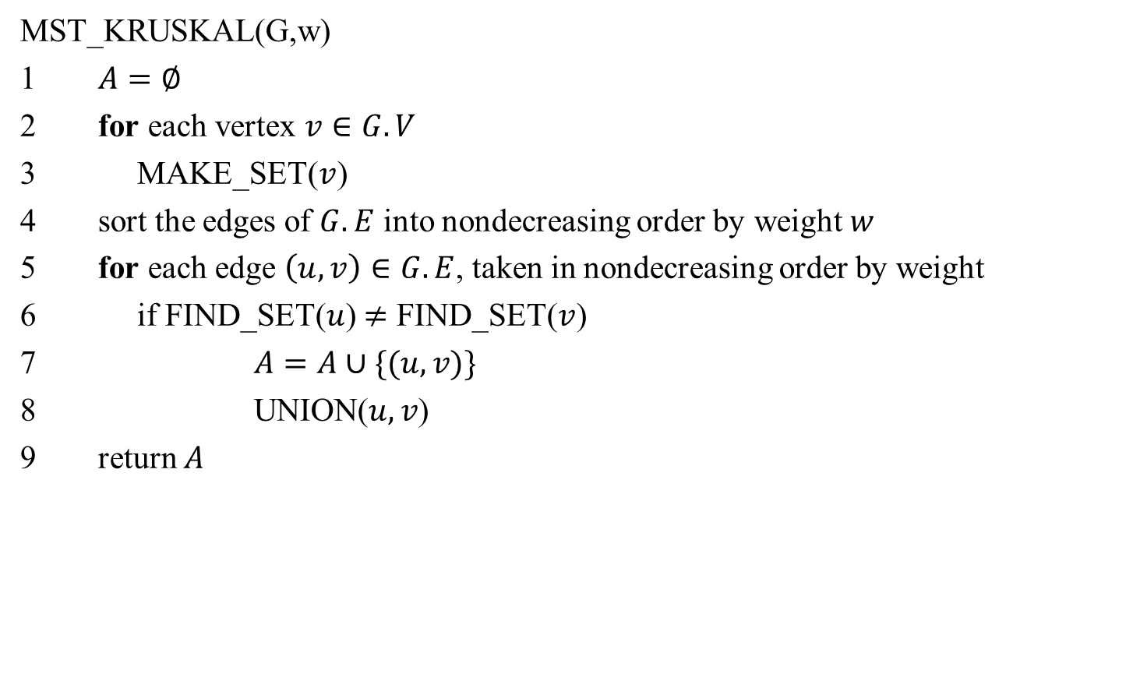
Kruskal's Algorithm
MST_KRUSKAL(G,w)
1 $A=∅$
2 for each vertex $v∈G.V$
3 MAKE_SET($v$)
4 sort the edges of $G.E$ into nondecreasing order by weight $w$
5 for each edge $\left(u,v\right)∈G.E$, taken in nondecreasing order by weight
6 if FIND_SET($u$) $≠$ FIND_SET($v$)
7 $A=A∪\{(u,v)\}$
8 UNION($u,v$)
return $A$

Slide 18
Kruskal’s algorithm
Basic idea:
Grow many small trees
Find two trees that are closest (i.e., connected with the lightest edge), join them with the lightest edge
Terminate when a single tree forms

Slide 19
Time Complexity of Kruskal's Algorithm
Line 4 sorts E edges => it takes O(E lgE) time, if we use MergeSort
But lg E = O(lg V), since E < V² => lg E < 2 lg V => lg E is O(lg V)
Hence O(E lg E) = O(E lg V)
If we make total m calls of Make_set, Union, and Find_set in any algorithm, then these calls will take total O(m lg n) time, where n is the number of Make-Set calls.
The 1st for loop makes O(V) MAKE_SET() calls and the 2nd for loop makes O(E) Find_SET and UNION calls
Total O(V+E) calls of MAKE_SET, FIND_SET, and UNION, out of which O(V) calls were MAKE_SET calls => O((V+E) lgV) time
E ≥ V-1, since the graph is connected
=> V is O(E)=> O((V+E) lgV) = O(E lgV)
Hence total time = O(E lg V)

Slide 20
Kruskal's Algorithm: Example
The edges considered by the algorithm are sorted by weight.
The edge under consideration at each step is shown with a red weight number.
8
7
b
c
d
9
4
2
a
11
i
14
e
4
7
6
8
10
h
g
f
1
2

Slide 21
Kruskal's Algorithm: Example
The edges are considered by the algorithm in sorted order by weight.
The edge under consideration at each step is shown with a red weight number.
8
7
b
c
d
9
4
2
a
11
i
14
e
4
7
6
8
10
h
g
f
1
2

Slide 22
Kruskal's Algorithm: Example
The edges are considered by the algorithm in sorted order by weight.
The edge under consideration at each step is shown with a red weight number.
8
7
b
c
d
9
4
2
a
11
i
14
e
4
7
6
8
10
h
g
f
1
2

Slide 23
Kruskal's Algorithm: Example
The edges are considered by the algorithm in sorted order by weight.
The edge under consideration at each step is shown with a red weight number.
8
7
b
c
d
9
4
2
a
11
i
14
e
4
7
6
8
10
h
g
f
1
2

Slide 24
Kruskal's Algorithm: Example
The edges are considered by the algorithm in sorted order by weight.
The edge under consideration at each step is shown with a red weight number.
8
7
b
c
d
9
4
2
a
11
i
14
e
4
7
6
8
10
h
g
f
1
2

Slide 25
Kruskal's Algorithm: Example
The edges are considered by the algorithm in sorted order by weight.
The edge under consideration at each step is shown with a red weight number.
8
7
b
c
d
9
4
2
a
11
i
14
e
4
7
6
8
10
h
g
f
1
2

Slide 26
Kruskal's Algorithm: Example
The edges are considered by the algorithm in sorted order by weight.
The edge under consideration at each step is shown with a red weight number.
8
7
b
c
d
9
4
2
a
11
i
14
e
4
7
6
8
10
h
g
f
1
2

Slide 27
Kruskal's Algorithm: Example
The edges are considered by the algorithm in sorted order by weight.
The edge under consideration at each step is shown with a red weight number.
8
7
b
c
d
9
4
2
a
11
i
14
e
4
7
6
8
10
h
g
f
1
2

Slide 28
Kruskal's Algorithm: Example
The edges are considered by the algorithm in sorted order by weight.
The edge under consideration at each step is shown with a red weight number.
8
7
b
c
d
9
4
2
a
11
i
14
e
4
7
6
8
10
h
g
f
1
2

Slide 29
Kruskal's Algorithm: Example
The edges are considered by the algorithm in sorted order by weight.
The edge under consideration at each step is shown with a red weight number.
8
7
b
c
d
9
4
2
a
11
i
14
e
4
7
6
8
10
h
g
f
1
2

Slide 30
Kruskal's Algorithm: Example
The edges are considered by the algorithm in sorted order by weight.
The edge under consideration at each step is shown with a red weight number.
8
7
b
c
d
9
4
2
a
11
i
14
e
4
7
6
8
10
h
g
f
1
2

Slide 31
Kruskal's Algorithm: Example
The edges are considered by the algorithm in sorted order by weight.
The edge under consideration at each step is shown with a red weight number.
8
7
b
c
d
9
4
2
a
11
i
14
e
4
7
6
8
10
h
g
f
1
2

Slide 32
Kruskal's Algorithm
MST_KRUSKAL(G,w)
1 $A=∅$
2 for each vertex $v∈G.V$
3 MAKE_SET($v$)
4 sort the edges of $G.E$ into nondecreasing order by weight $w$
5 for each edge $\left(u,v\right)∈G.E$, taken in nondecreasing order by weight
6 if FIND_SET($u$) $≠$ FIND_SET($v$)
7 $A=A∪\{(u,v)\}$
8 UNION($u,v$)
return $A$

Slide 33
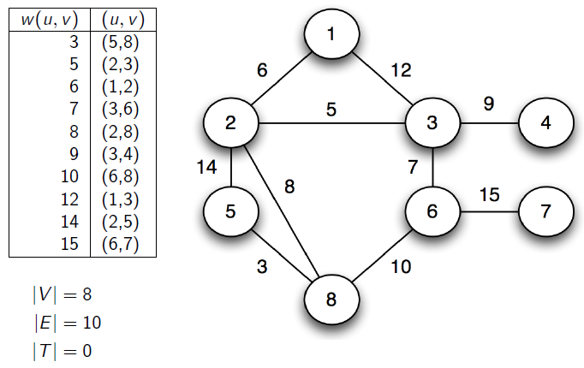
Kruskal’s algorithm in action

Slide 34
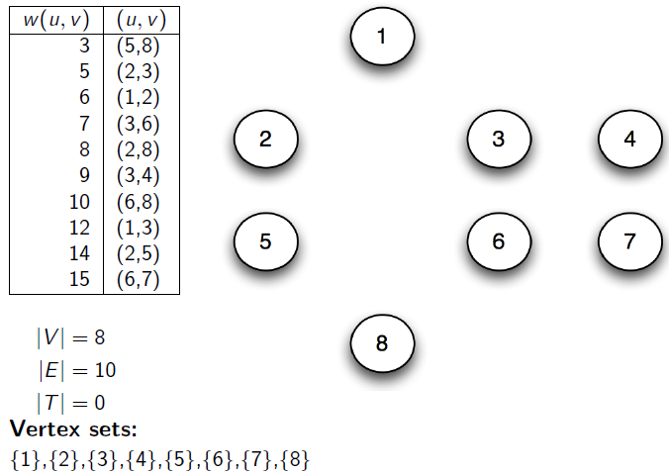
Kruskal’s algorithm in action

Slide 35
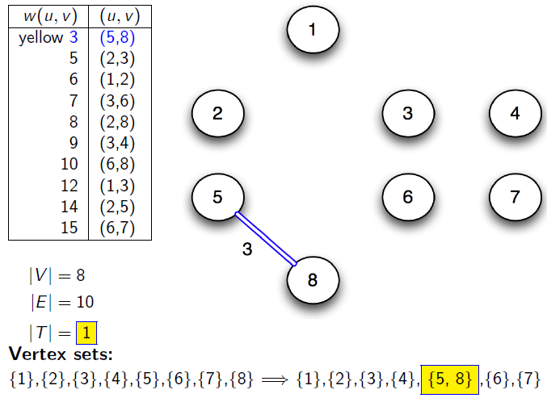
Kruskal’s algorithm in action

Slide 36
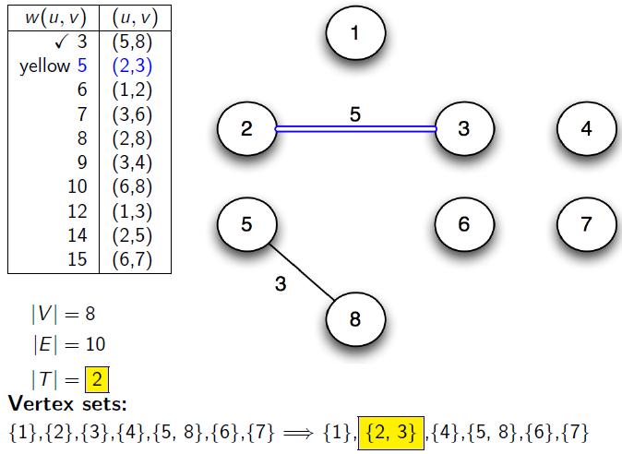
Kruskal’s algorithm in action

Slide 37
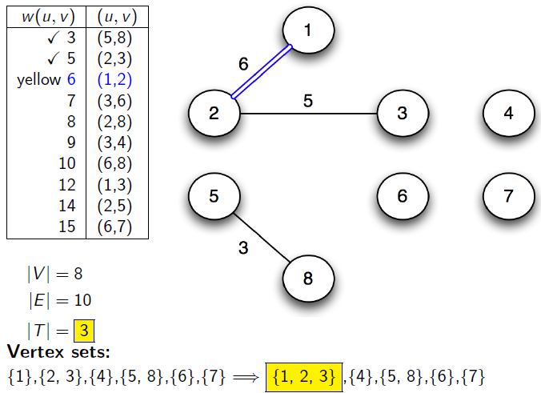
Kruskal’s algorithm in action

Slide 38
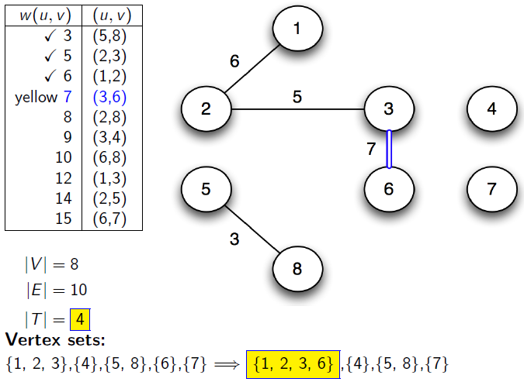
Kruskal’s algorithm in action

Slide 39
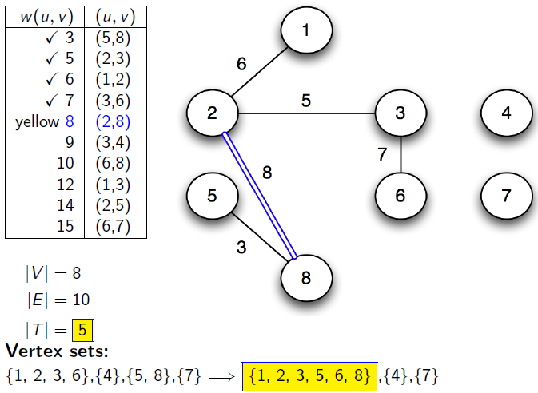
Kruskal’s algorithm in action

Slide 40
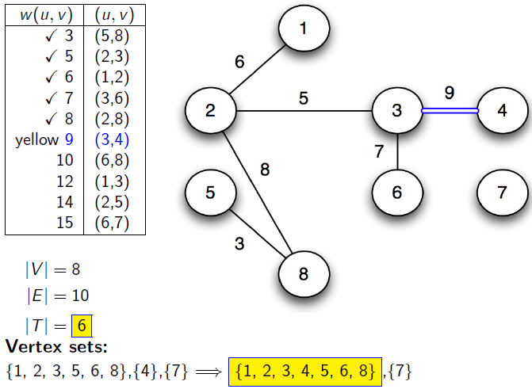
Kruskal’s algorithm in action

Slide 41
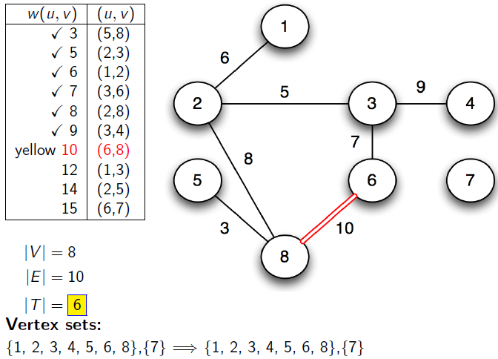
Kruskal’s algorithm in action

Slide 42
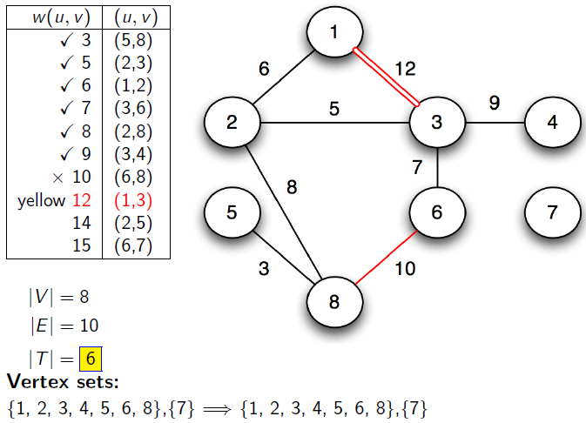
Kruskal’s algorithm in action

Slide 43
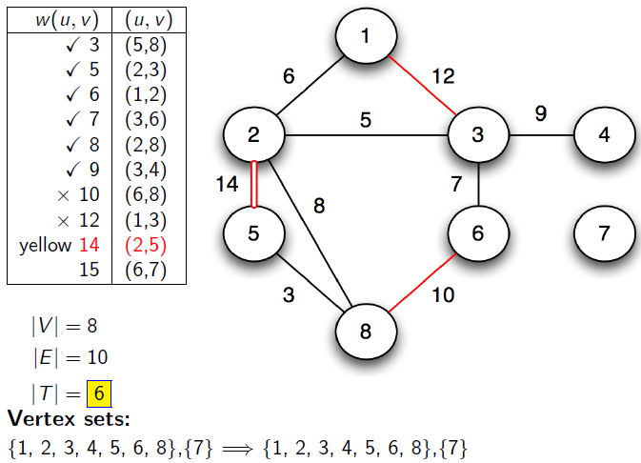
Kruskal’s algorithm in action

Slide 44
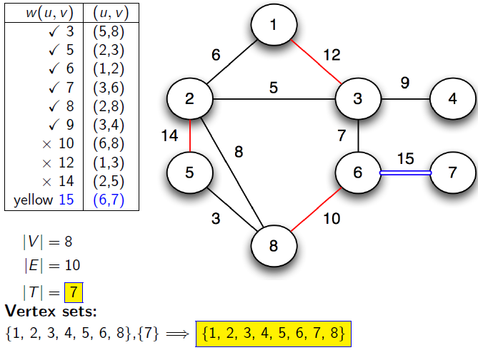
Kruskal’s algorithm in action

Slide 45
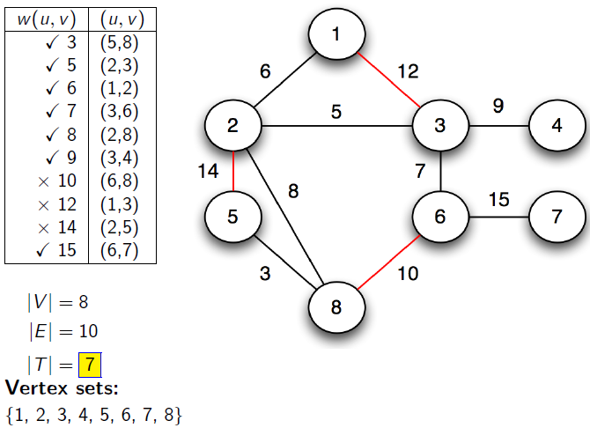
Kruskal’s algorithm in action

Slide 46
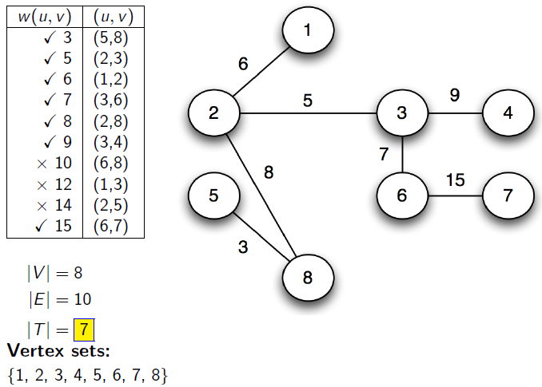
Kruskal’s algorithm in action

Slide 47
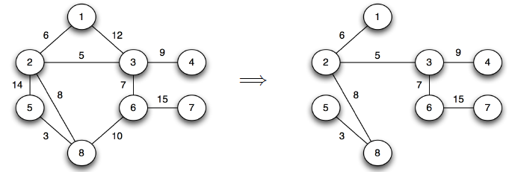
Kruskal’s algorithm in action

Slide 48

Prim's Algorithm
MST_PRIM(G,w,r)
1 for each $u$ in $G.V$
$u.key=∞$
$u.π=$NIL
4 $r.key=0$
5 $Q=G.V$ //Q is a min-priority queue
6 while $Q≠∅$
7 $u=$EXTRACT_MIN($Q$)
8 for each $v∈G.Adj[u]$
9 if $v∈Q$ and $w\left(u,v\right)<v.key$
10 $v.π=u$
11 $v.key=w(u,v)$

Slide 49
Prim's Algorithm
Grow the minimum spanning tree from the root vertex r.
Q is a priority queue, holding all vertices that are not in the tree now.
key[v] is the minimum weight of any edge connecting v to a vertex in the tree.
parent[v] names the parent of v in the tree.
When the algorithm terminates, Q is empty; the minimum spanning tree A for G is thus A={(v,parent[v]):v∈V-{r}}.
Running time: O(Elg V).

Slide 50
Running time of Prim's Algorithm
// O(V)
//Θ(V) time to build the heap
//V Heap-Extract-Min operations: O(V lg V)
//E Heap-Decrease-Key operations: O(E lg V)
Total time = O((V+E) lg V) = O(E lg V) since E ≥ V-1 => V is O(E)

Slide 51
Prim's Algorithm: Example
NIL,∞
8
NIL,∞
NIL,∞
the root vertex
c
7
d
b
9
4
NIL,∞
2
NIL,0
a
11
i
4
14
e
NIL,∞
7
6
8
10
h
g
f
NIL,∞
1
NIL,∞
2
NIL,∞

Slide 52
Prim's Algorithm: Example
a,4
8
NIL,∞
NIL,∞
c
7
d
b
9
4
NIL,∞
2
NIL,0
a
11
i
4
14
e
NIL,∞
7
6
8
10
h
g
f
a,8
1
NIL,∞
2
NIL,∞

Slide 53
Prim's Algorithm: Example
a,4
8
b,8
7
NIL,∞
b
c
d
9
4
NIL,∞
2
NIL,0
a
11
i
14
e
NIL,∞
4
7
6
8
10
h
g
f
a,8
1
NIL,∞
2
NIL,∞

Slide 54
Prim's Algorithm: Example
a,4
8
b,8
7
c,7
b
c
d
9
4
c,2
2
NIL,0
a
11
i
14
e
NIL,∞
4
7
6
8
10
h
g
f
a,8
1
NIL,∞
2
c,4

Slide 55
Prim's Algorithm: Example
a,4
8
b,8
7
c,7
b
c
d
9
4
c,2
2
NIL,0
a
11
i
14
e
NIL,∞
4
7
6
8
10
h
g
f
i,7
1
i,6
2
c,4

Slide 56
Prim's Algorithm: Example
a,4
8
b,8
7
c,7
b
c
d
9
4
c,2
2
NIL,0
a
11
i
14
e
f,10
4
7
6
8
10
h
g
f
i,7
1
f,2
2
c,4

Slide 57
Prim's Algorithm: Example
a,4
8
b,8
7
c,7
b
c
d
9
4
c,2
2
NIL,0
a
11
i
14
e
f,10
4
7
6
8
10
h
g
f
g,1
1
f,2
2
c,4

Slide 58
Prim's Algorithm: Example
a,4
8
b,8
7
c,7
b
c
d
9
4
c,2
2
NIL,0
a
11
i
14
e
f,10
4
7
6
8
10
h
g
f
g,1
1
f,2
2
c,4

Slide 59
Prim's Algorithm: Example
a,4
8
b,8
7
c,7
b
c
d
9
4
c,2
2
NIL,0
a
11
i
14
e
d,9
4
7
6
8
10
h
g
f
g,1
1
f,2
2
c,4

Slide 60
Prim's Algorithm: Example
a,4
8
b,8
7
c,7
b
c
d
9
4
c,2
2
NIL,0
a
11
i
14
e
d,9
4
7
6
8
10
h
g
f
g,1
1
f,2
2
c,4

Slide 61
Prim Algorithm:Variables
r:Grow the minimum spanning tree from the root vertex “r”.
Q: is a priority queue, holding all vertices that are not in the tree now.
key[v]: is the minimum weight of any edge connecting v to a vertex in the tree.
π [v]: names the parent of v in the tree.
T[v] – Vertex v is already included in MST if T[v]==1, otherwise, it is not included yet.
Removing v from set Q adds it to set Q-V of vertices in tree, thus adding (v, p[ v]) to A.

Slide 62
Prim Algorithm (2)
MST-Prim(G,r)
01 Q ← V[G] // Q – vertices out of T
02 for each u ∈ Q
03 key[u] ← ∞
04 key[r] ← 0 // r is the first tree node, let r=1
05 π[r] ← NIL
06 while Q ≠ ∅ do
07 u ← ExtractMin(Q) // making u part of T
08 for each v ∈ Adj[u] do
09 if v ∈ Q and w(u,v) < key[v] then
10 π[v] ← u
11 key[v] ← w(u,v)

Slide 63
The execution of Prim's algorithm
8
7
the root vertex
b
c
d
9
4
2
a
11
i
14
e
4
7
6
8
10
h
g
f
1
2
V | a | b | c | d | e | f | g | h | i
T | 1 | 0 | 0 | 0 | 0 | 0 | 0 | 0 | 0
Key | 0 | - | - | - | - | - | - | - | -
π | -1 | - | - | - | - | - | - | - | -

Slide 64
The execution of Prim's algorithm
8
7
the root vertex
b
c
d
9
4
2
a
11
i
14
e
4
7
6
8
10
h
g
f
1
2
V | a | b | c | d | e | f | g | h | i
T | 1 | 0 | 0 | 0 | 0 | 0 | 0 | 0 | 0
Key | 0 | 4 | - | - | - | - | - | 8 | -
π | -1 | a | - | - | - | - | - | a | -
64

Slide 65
The execution of Prim's algorithm
8
7
the root vertex
b
c
d
9
4
2
a
11
i
14
e
4
7
6
8
10
h
g
f
1
2
Important: Update Key[v] only if T[v]==0
V | a | b | c | d | e | f | g | h | i
T | 1 | 1 | 0 | 0 | 0 | 0 | 0 | 0 | 0
Key | 0 | 4 | 8 | - | - | - | - | 8 | -
π | -1 | a | b | - | - | - | - | a | -
65

Slide 66
The execution of Prim's algorithm
8
7
the root vertex
b
c
d
9
4
2
a
11
i
14
e
4
7
6
8
10
h
g
f
1
2
V | a | b | c | d | e | f | g | h | i
T | 1 | 1 | 1 | 0 | 0 | 0 | 0 | 0 | 0
Key | 0 | 4 | 8 | 7 | - | 4 | - | 8 | 2
π | -1 | a | b | c | - | c | - | a | c
66

Slide 67
The execution of Prim's algorithm
8
7
the root vertex
b
c
d
9
4
2
a
11
i
14
e
4
7
6
8
10
h
g
f
1
2
V | a | b | c | d | e | f | g | h | i
T | 1 | 1 | 1 | 0 | 0 | 0 | 0 | 0 | 1
Key | 0 | 4 | 8 | 7 | - | 4 | 6 | 7 | 2
π | -1 | a | b | c | - | c | i | i | c
67

Slide 68
The execution of Prim's algorithm
8
7
the root vertex
b
c
d
9
4
2
a
11
i
14
e
4
7
6
8
10
h
g
f
1
2
V | a | b | c | d | e | f | g | h | i
T | 1 | 1 | 1 | 0 | 0 | 1 | 0 | 0 | 1
Key | 0 | 4 | 8 | 7 | 10 | 4 | 2 | 7 | 2
π | -1 | a | b | c | f | c | f | i | c
68

Slide 69
The execution of Prim's algorithm
8
7
the root vertex
b
c
d
9
4
2
a
11
i
14
e
4
7
6
8
10
h
g
f
1
2
V | a | b | c | d | e | f | g | h | i
T | 1 | 1 | 1 | 0 | 0 | 1 | 1 | 0 | 1
Key | 0 | 4 | 8 | 7 | 10 | 4 | 2 | 1 | 2
π | -1 | a | b | c | f | c | f | g | c
69

Slide 70
The execution of Prim's algorithm
8
7
the root vertex
b
c
d
9
4
2
a
11
i
14
e
4
7
6
8
10
h
g
f
1
2
V | a | b | c | d | e | f | g | h | i
T | 1 | 1 | 1 | 0 | 0 | 1 | 1 | 1 | 1
Key | 0 | 4 | 8 | 7 | 10 | 4 | 2 | 1 | 2
π | -1 | a | b | c | f | c | f | g | c
70

Slide 71
The execution of Prim's algorithm
8
7
the root vertex
b
c
d
9
4
2
a
11
i
14
e
4
7
6
8
10
h
g
f
1
2
V | a | b | c | d | e | f | g | h | i
T | 1 | 1 | 1 | 1 | 0 | 1 | 1 | 1 | 1
Key | 0 | 4 | 8 | 7 | 9 | 4 | 2 | 1 | 2
π | -1 | a | b | c | d | c | f | g | c
71

Slide 72
The execution of Prim's algorithm
8
7
the root vertex
b
c
d
9
4
2
a
11
i
14
e
4
7
6
8
10
h
g
f
1
2
V | a | b | c | d | e | f | g | h | i
T | 1 | 1 | 1 | 1 | 1 | 1 | 1 | 1 | 1
Key | 0 | 4 | 8 | 7 | 9 | 4 | 2 | 1 | 2
π | -1 | a | b | c | d | c | f | g | c
72

Slide 73
Complexity: Prim Algorithm
MST-Prim(G,r)
01 Q ← V[G] // Q – vertices out of T
02 for each u ∈ Q
03 key[u] ← ∞
04 key[r] ← 0
05 π[r] ← NIL
06 while Q ≠ ∅ do
07 u ← ExtractMin(Q) // making u part of T
08 for each v ∈ Adj[u] do
09 if v ∈ Q and w(u,v) < key[v] then
10 π[v] ← u
11 key[v] ← w(u,v)
O(V)
O(V)
Heap: O(lgV)
Overall: O(E)
Decrease Key: O(lgV)
Overall complexity: O(V)+O(V lg V+E lg V) = O(E lg V)

